Slide 1
Air Quality Monitoring
Team Members
1.Sanjiv Kanth. K
2.Shoban babu. R
3.Vigensh.B
4.Vimal babu. M
5.Yugandhar . M

Slide 2
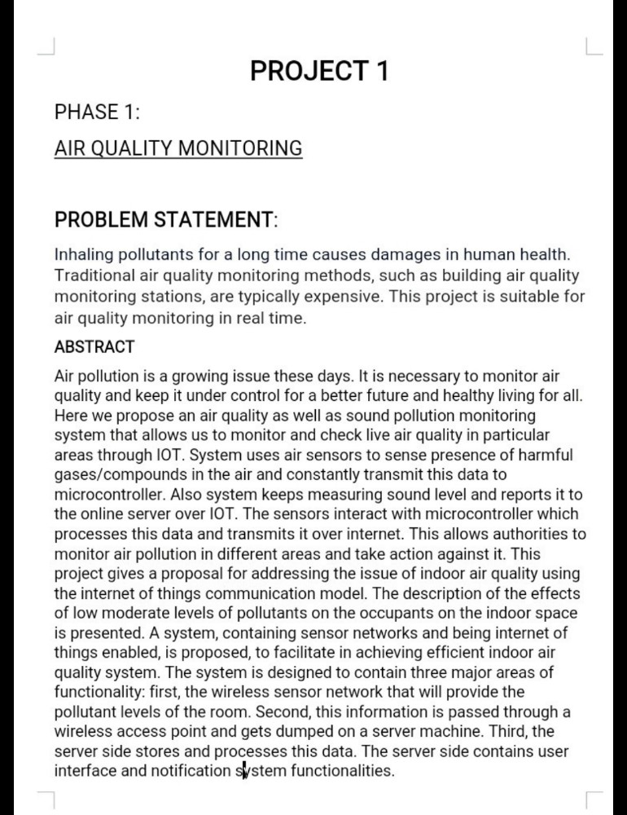

Slide 3
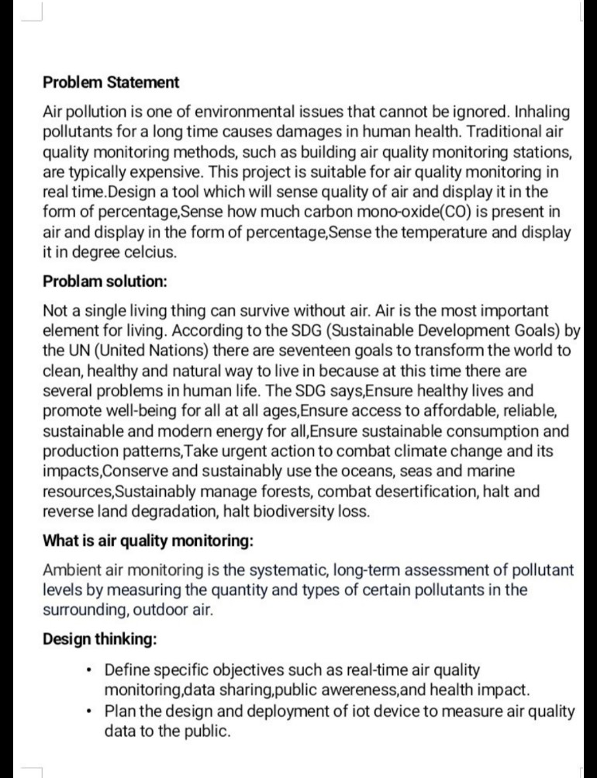

Slide 4
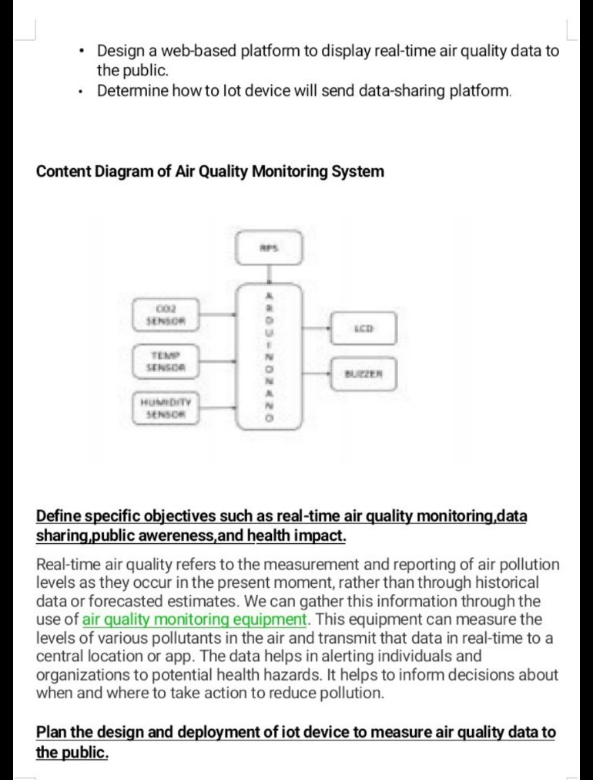

Slide 5
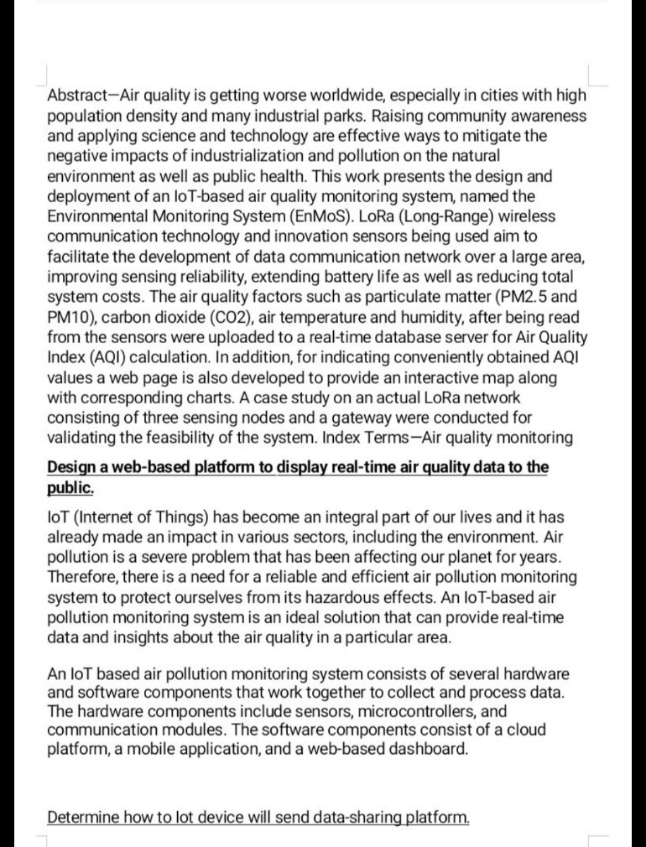

Slide 6
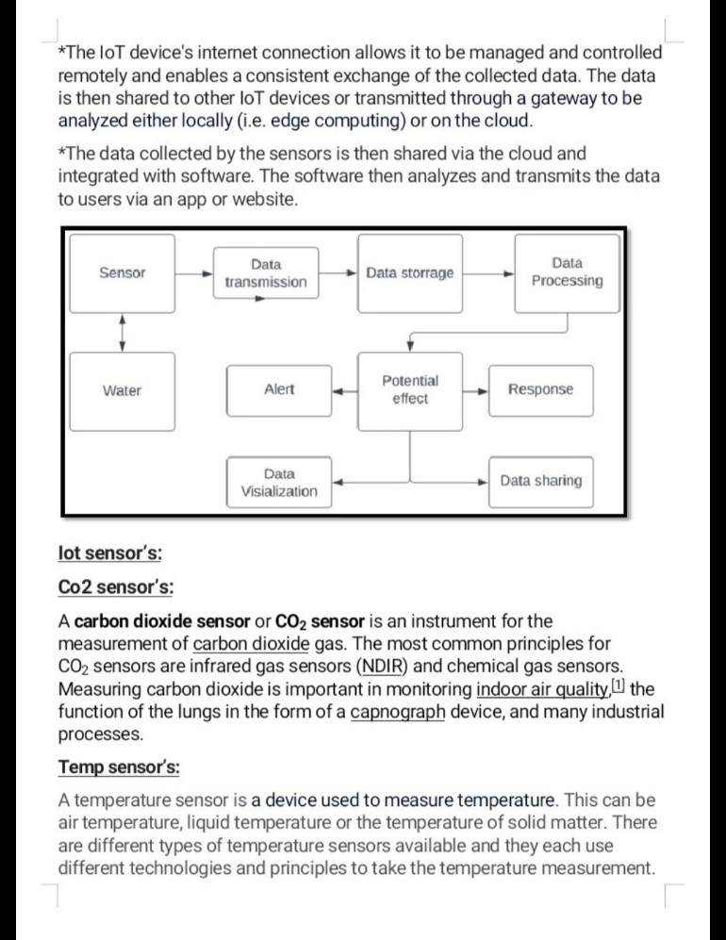

Slide 7
